Slide 1
Suicide Rates Prediction Using Regression.
MUHAMMAD AMMAR ZAKWAN BIN AMRAN 1712711
MUHAMMAD HARITH BIN KHAIROLANUAR 1816349
AHMAD ZAIDAN BIN ADNAN 1718733

Slide 2
Introduction
Our group selects Suicide in Southeast Asia as our dataset.
We are using regression for our algorithm to predict the number of suicide rates.
For this model, we are using linear regression

Slide 3
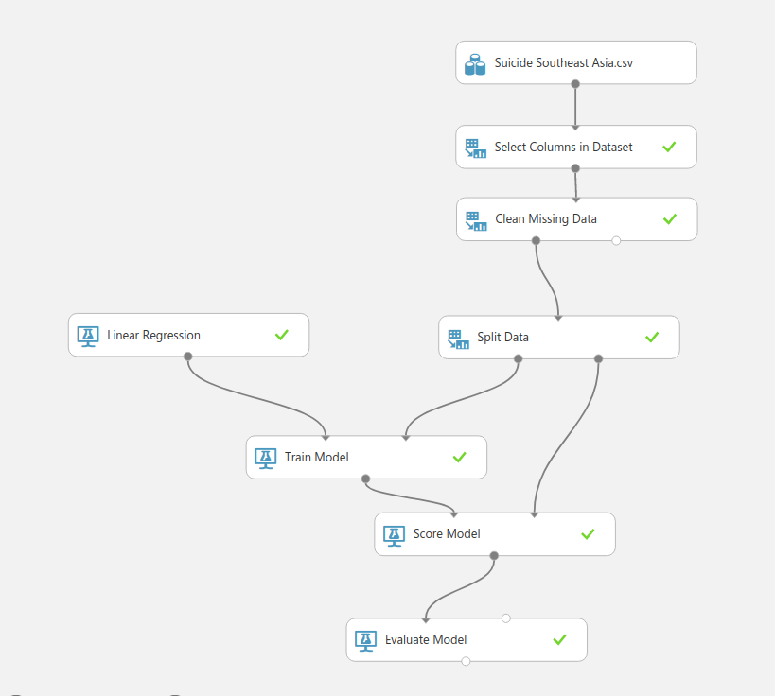
This is our machine learning experiment:

Slide 4
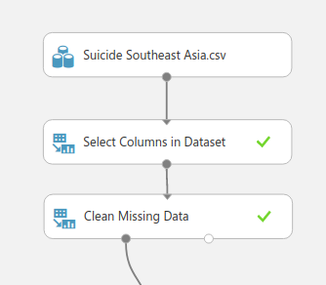
Select Columns in Dataset
Firstly, we exclude the unimportant column using the Select Columns in Dataset module. Below is the Column of our visualize dataset. We are excluding suicides_no, country-year, HDI for year, gdp_for_year($), gdp_per_capita($), and generation.
Before:
After :

Slide 5

Clean Missing Data
Next we use Clean Missing Data module to clean the data by removing rows that have any missing values.
Before:
After :

Slide 6
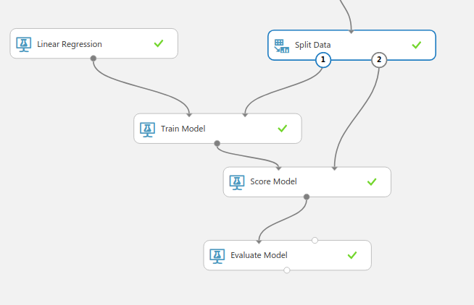
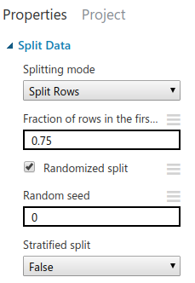
Split Data
Next, we split the data set it to 0.75. This way, we'll use 75 percent of the data to train the model, and hold back 25 percent for testing.
Before:
After :

Slide 7
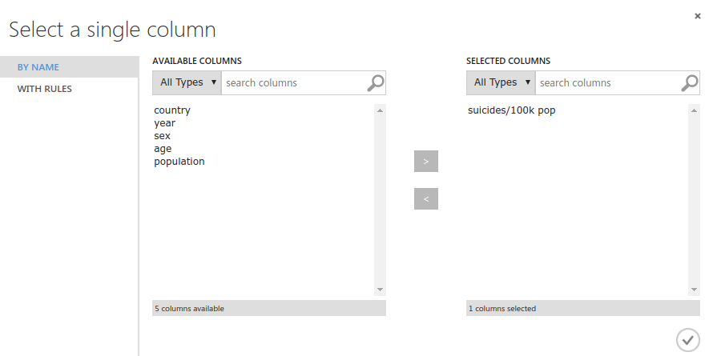
Train Model
Next, we use Train Model module. suicides/100k pop is the column that we use for prediction.
Before:
After :

Slide 8
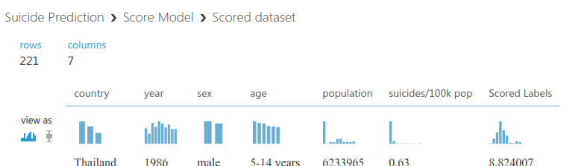
Score Model
After training the 75 percent in Train Model, we connect the Train Model and Split Data to the Score Model. suicides/100k pop is the column that we use for prediction. The output below shows the predicted values for suicides/100k pop(Scored Labels) and the known values from the test data(suicides/100k pop).
Before:
After :

Slide 9
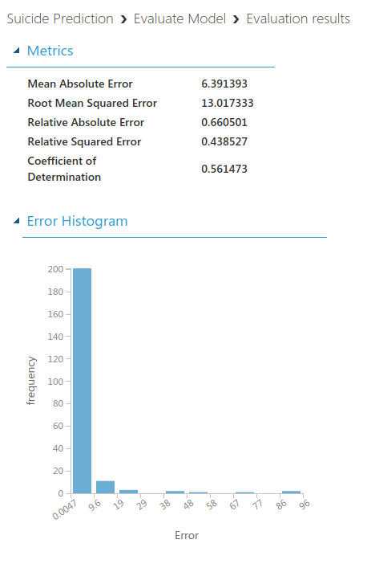
Evaluate Model
The Smaller is better for each of the error statistics
For Coefficient of Determination, the closer its value is to one (1.0), the better the predictions.

Slide 10
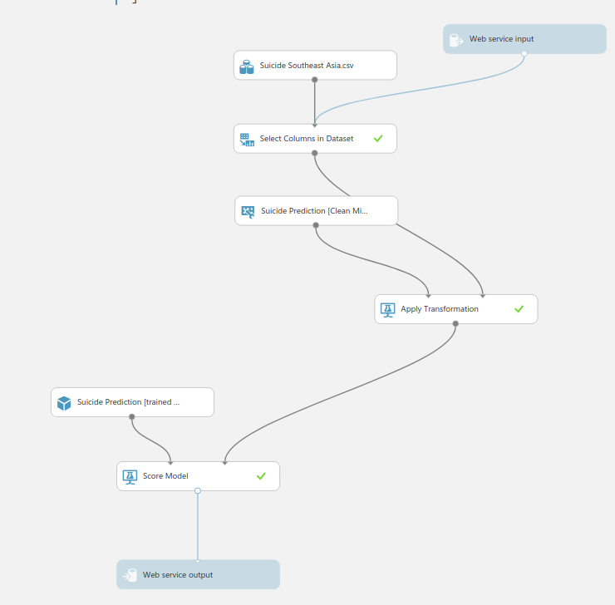
Deploy Web Service
After that, we deploy the web service by choosing predictive. The Right Diagram show the result of the deploy web service.

Slide 11
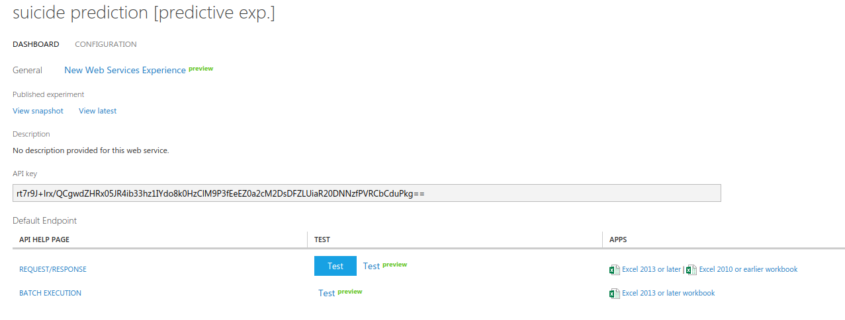
Predictive Experiment
After that click run, then click deploy web service. We get the output below. Then click Test button to predict the suicide rate.

Slide 12
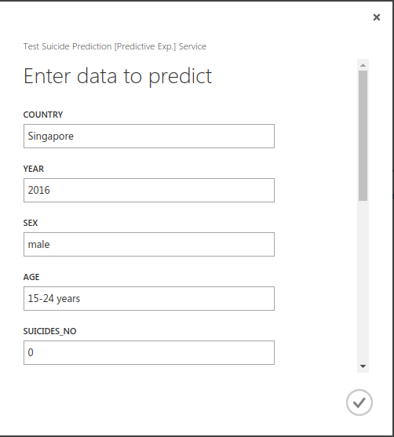
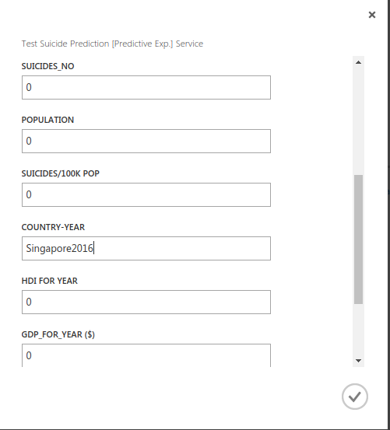
Predictive Experiment
Next, we fill the form to predict the outcome based on year. We continue test it until year 2019.

Slide 13

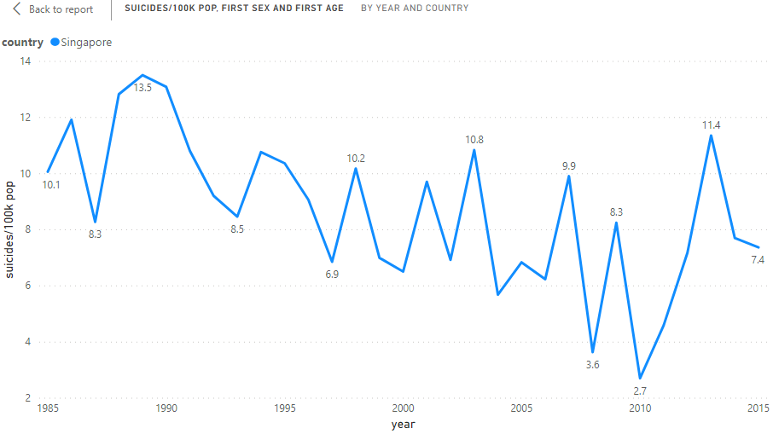
Predictive Experiment
Here is the result of our experiment.

Slide 14
Conclusion

